Slide 1

Sports Injury Prediction
Presented by: Era Ebhodaghe
Bellevue University
Project #1
DSC 680 Applied Data Science
Oct 4th, 2025

Slide 2
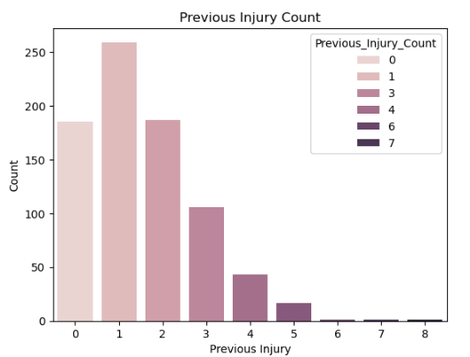
Introduction
This project analyzes a dataset of 800 Chinese university football players.
Machine learning was applied to predict whether a player may sustain an injury next season.
The project also identifies key risk factors to guide training and injury prevention.

Slide 3
Business Problem
Sports injuries are costly, reduce playing time, and affect team performance.
Predictive analytics can identify at-risk players, guide training programs, and improve recruitment decisions.

Slide 4
Background / History
Sports injuries are either acute (sudden) or chronic (long-term overuse).
Examples: sprains, strains, tendinitis, fractures.
Understanding injury types and risk factors helps in prevention (NIAMS, 2024).

Slide 5
Data Source
Dataset from Kaggle, 800 football players.
18 input features, 1 target label (injury: yes/no).
Age range: 18–24 years, balanced dataset.

Slide 6
Feature Categories
Physical: Age, Height, Weight, BMI
Football-Specific: Position, training hours, matches, injury history
Fitness: Knee strength, flexibility, speed, balance, agility
Lifestyle: Sleep, stress, nutrition
Compliance: Warm-up adherence

Slide 7
Methods
Data analyzed using Python (NumPy, Pandas, Matplotlib, Seaborn, Scikit-learn).
Models: Decision Tree, Random Forest, Logistic Regression.
Goal: Predict injuries while ensuring interpretability and accuracy.

Slide 8
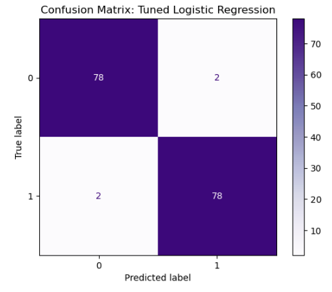
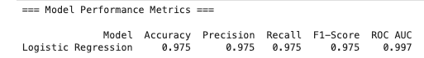
Analysis
Preprocessing: encoding, scaling, splitting into training/testing.
Algorithms: Random Forest, Decision Tree, Gradient Boosting, Logistic Regression.
Best performance: Logistic Regression with Recall 0.975, Accuracy 0.975, ROC AUC 0.997.

Slide 9
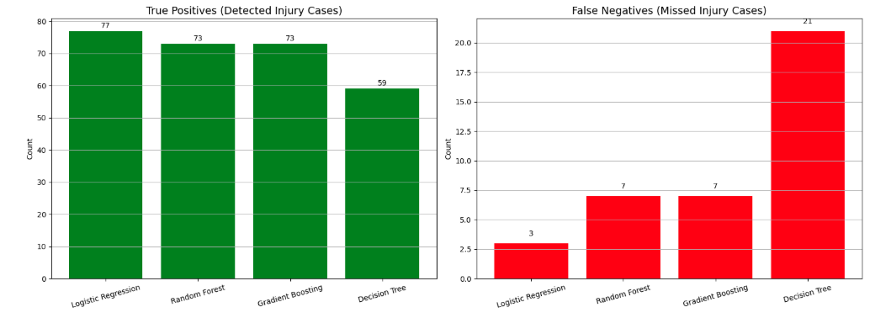
Conclusion
Logistic Regression performed best in identifying true injury cases.
Key predictors: Knee Strength, Flexibility, Reaction Time, Balance, Speed, Sleep, Stress.
Results emphasize rest, flexibility, and stress management in injury prevention.

Slide 10
Assumptions
Dataset represents target population.
Self-reported data is accurate.
Health variables remain stable over time.
No critical factors missing from dataset.

Slide 11
Limitations
Dataset limited to 800 athletes.
Missing risk factors (e.g., genetics, medical history).
Self-reported measures (sleep, stress) may be unreliable.
Potential for bias in predictions.

Slide 12
Challenges
Ensuring data quality and fairness.
Handling dynamic injury risks.
Integrating predictive insights ethically.
Training staff to use the system responsibly.

Slide 13
Recommendations
Use predictive modeling in university sports program.
Focus on improving knee strength, flexibility, balance, and stress management.
Apply results as supportive tools, not sole decision-making factors.

Slide 14
Implementation Plan
Collect consistent player health data each season.
Retrain and update model regularly.
Provide user-friendly access for coaches and medical staff.
Ensure ethical use and monitoring.

Slide 15
Ethical Assessment
Analysis is intended for training and prevention only.
Should not bias player selection decisions.
Final decisions should be based on holistic performance evaluation.

Slide 16
Audience Q&A
1. How does the model account for sudden injuries?
2. Why prioritize Logistic Regression?
3. How to integrate predictions into daily coaching?
4. Plans to expand dataset?
5. How reliable are self-reported factors?
6. How to avoid bias?
7. How often retrain model?
8. What interventions for high-risk athletes?
9. What ethical safeguards are in place?
10. Can this apply to other sports?

Slide 17
References
National Institute of Arthritis and Musculoskeletal and Skin Diseases “Sports Injuries,” accessed September 14, 2025, https://www.niams.nih.gov/health-topics/sports-injuries
Kaggle. (2025). “University Football Injury Prediction Dataset” [Dataset]. Kaggle. https://www.kaggle.com/datasets/yuanchunhong/university-football-injury-prediction-dataset?resource=download

